Slide 1

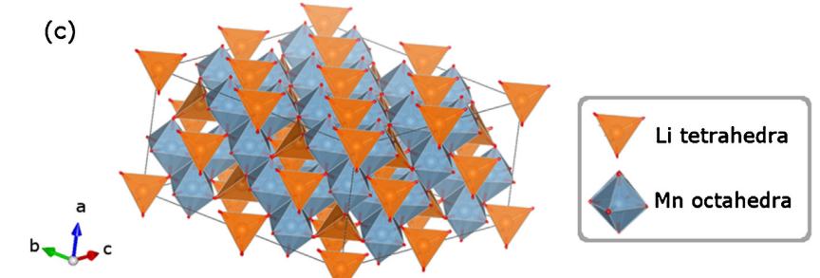
Multi-scale approach to LMO

Slide 2
Multi-scale scheme
DFT: Energy barriers for diffusion and intercalation in LMO
MC: Thermodynamic study with potential energy tacken from previous Mean-Field work (work in progress).
kMC: galvanostatic and potentiostatic simulations, calculation of D(x)
Numerical simulations: construction of capacity level diagram with D(x) obtained from kMC and with experimental data
First principles
(German/Brazilian group)
SimStack
Atomic-Molecular level
(Both groups)
(Argentina group)
Continuum
(Argentina group)

Slide 3
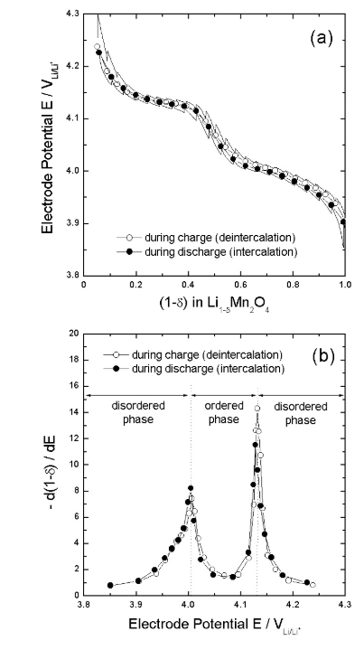


LMO cathode
Spinel structure
Cubic crystal (space group Fd3m)
Li sits in tetrahedral 8a sites of oxygen tetrahedron, whereas Mn, which resides in the 16d positions, is coordinated to oxygen in the form of octahedra
https://materialsproject.org/materials/mp-25015/
The lithium intercalation/deintercalation into/from the 8a tetrahedral sites occurs at about 4 V with the maintaining of the initial cubic spinel symmetry.

Slide 4
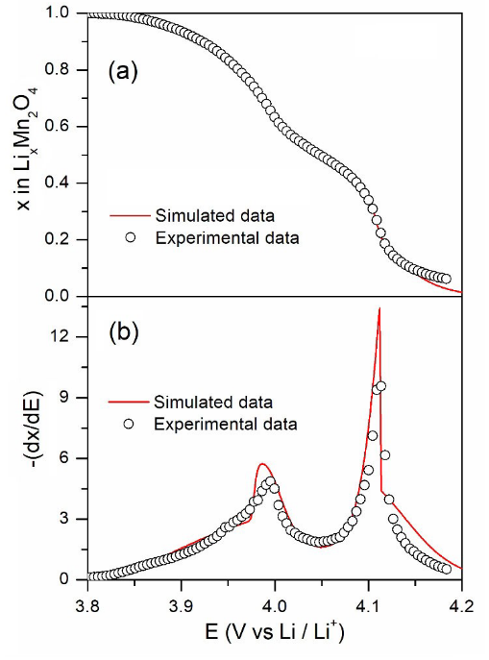
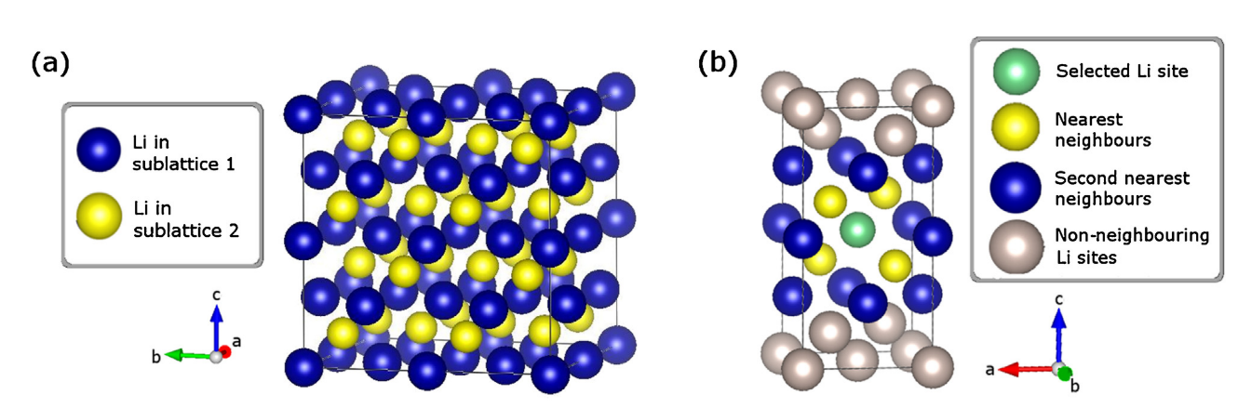
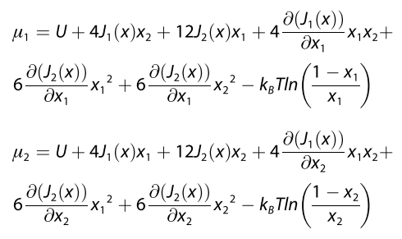
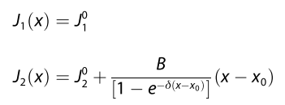
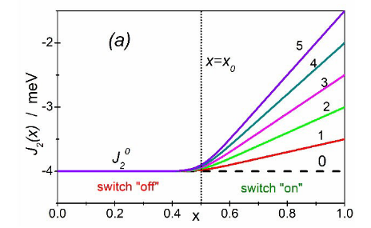


Mean-Field (MF) modelling
Gavilán-Arriazu et al., ChemPhysChem 2021, 22, 1–12
8a sites
$$J_{1}(x)$$
$$J_{2}(x)$$

Slide 5
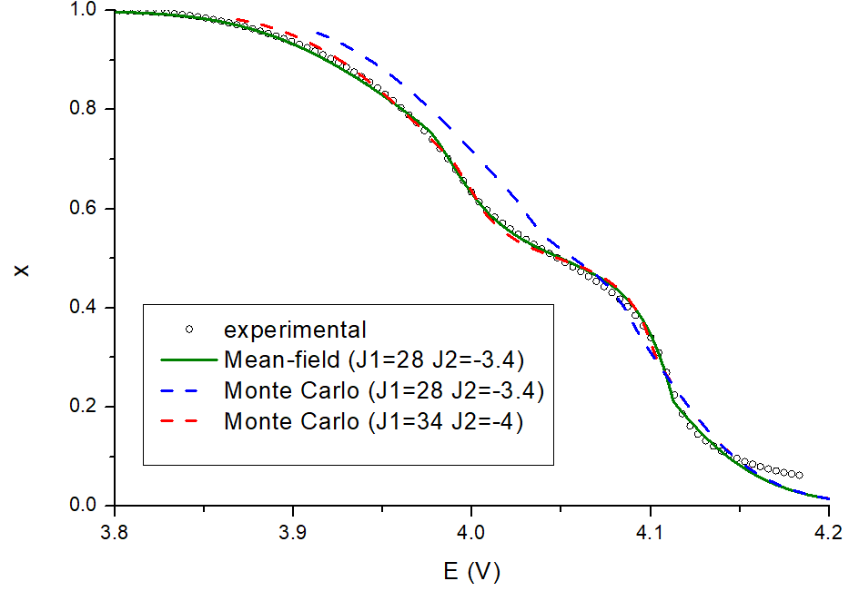

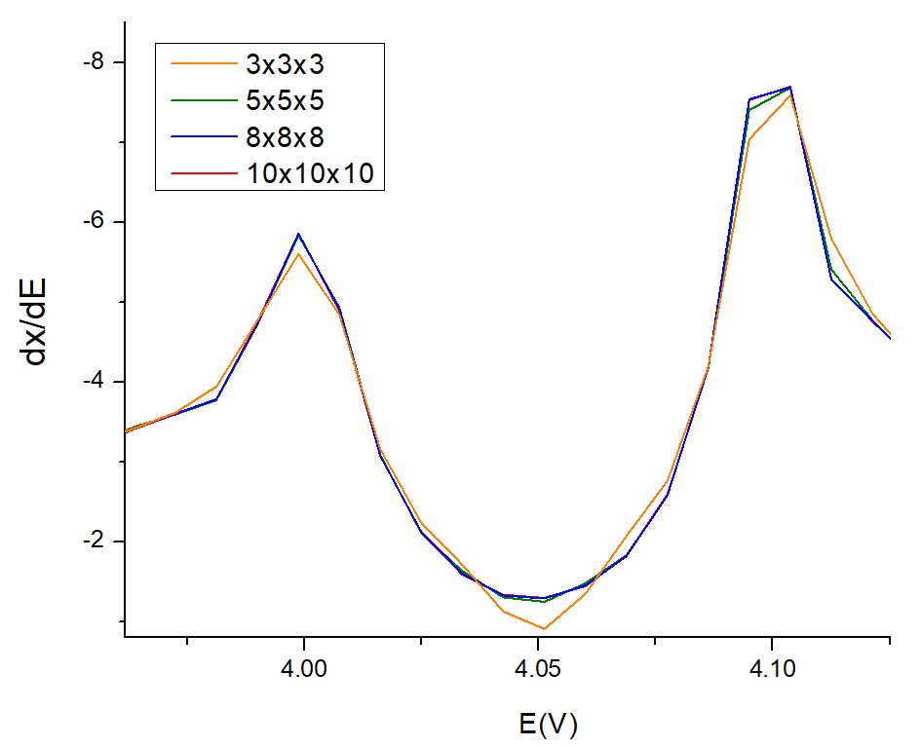
Monte Carlo (MC)
Comparison MF, MC and experimental
Preliminary results
Finite-size effect

Slide 6
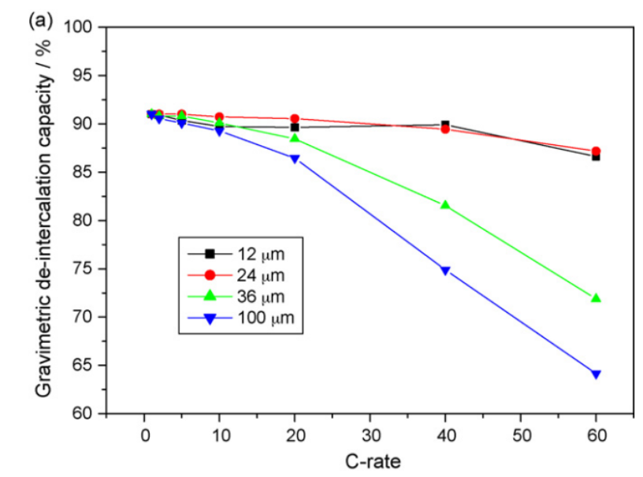
Numerical simulations at continuum level
Background: Galvanostatic Charging
C-rate
Particle size
Wang, R. et al.. Nature communications, 2021, 12(1), 1-10.
Sivakkumar et al. Electrochimica Acta 55 (2010) 3330–3335

Slide 7
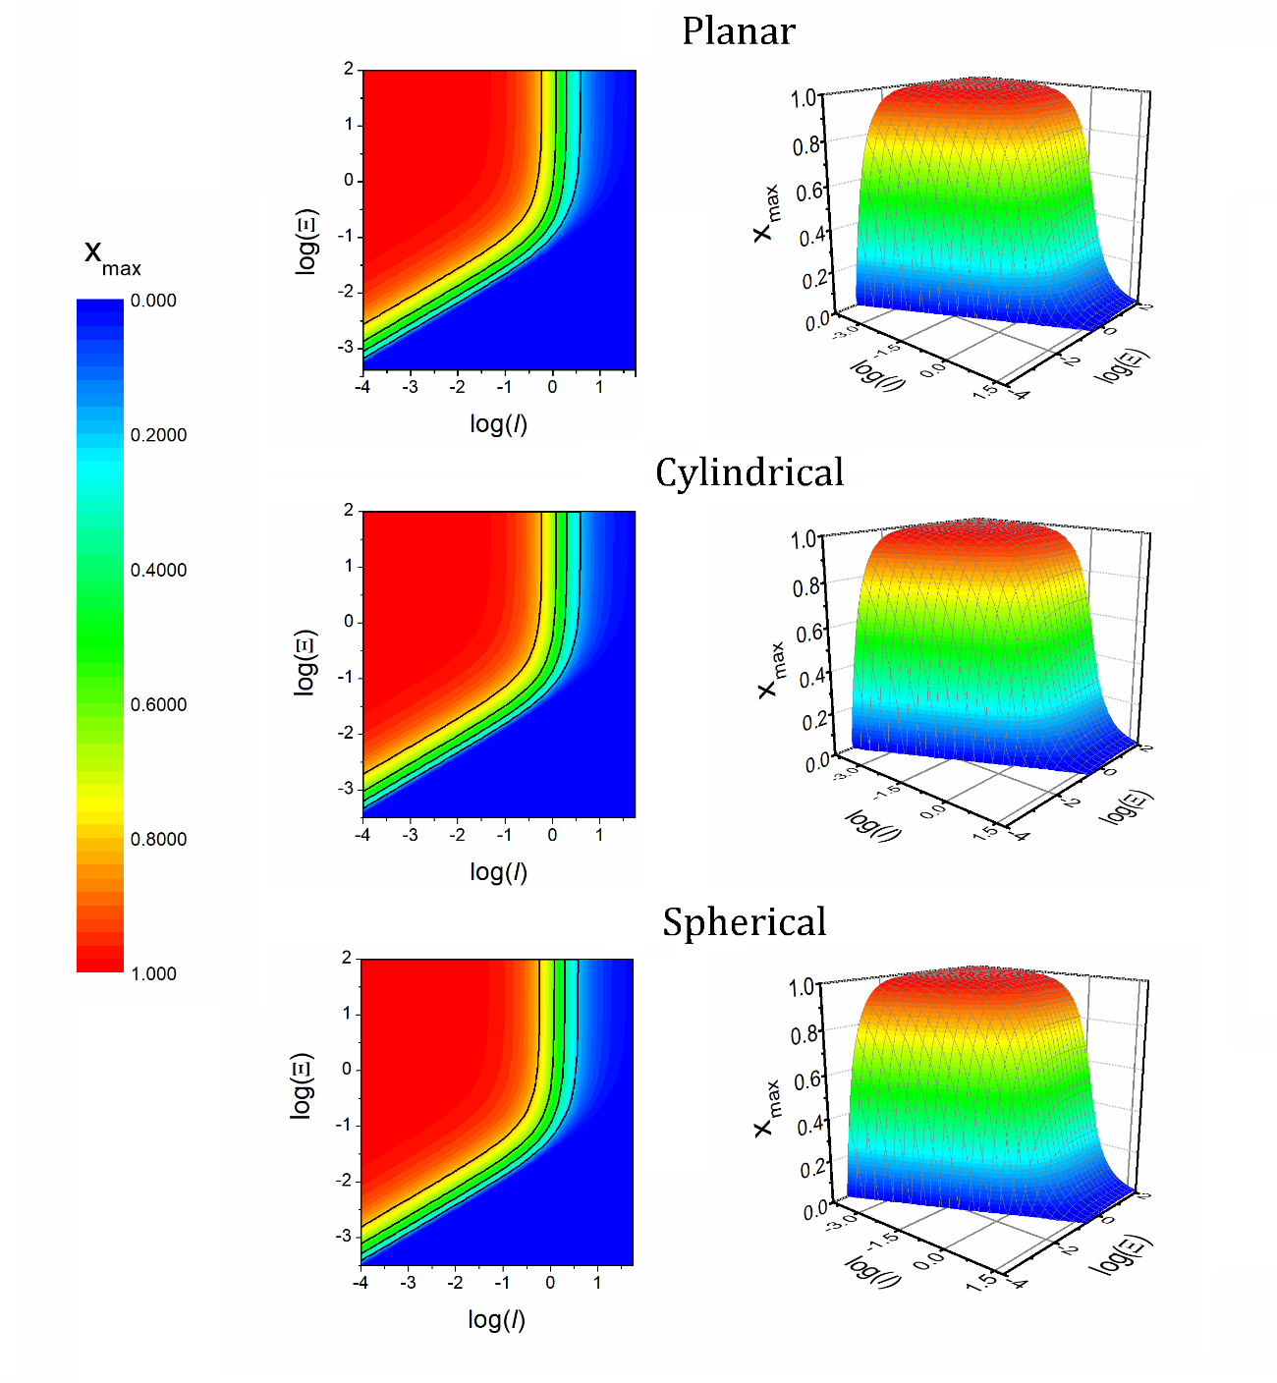
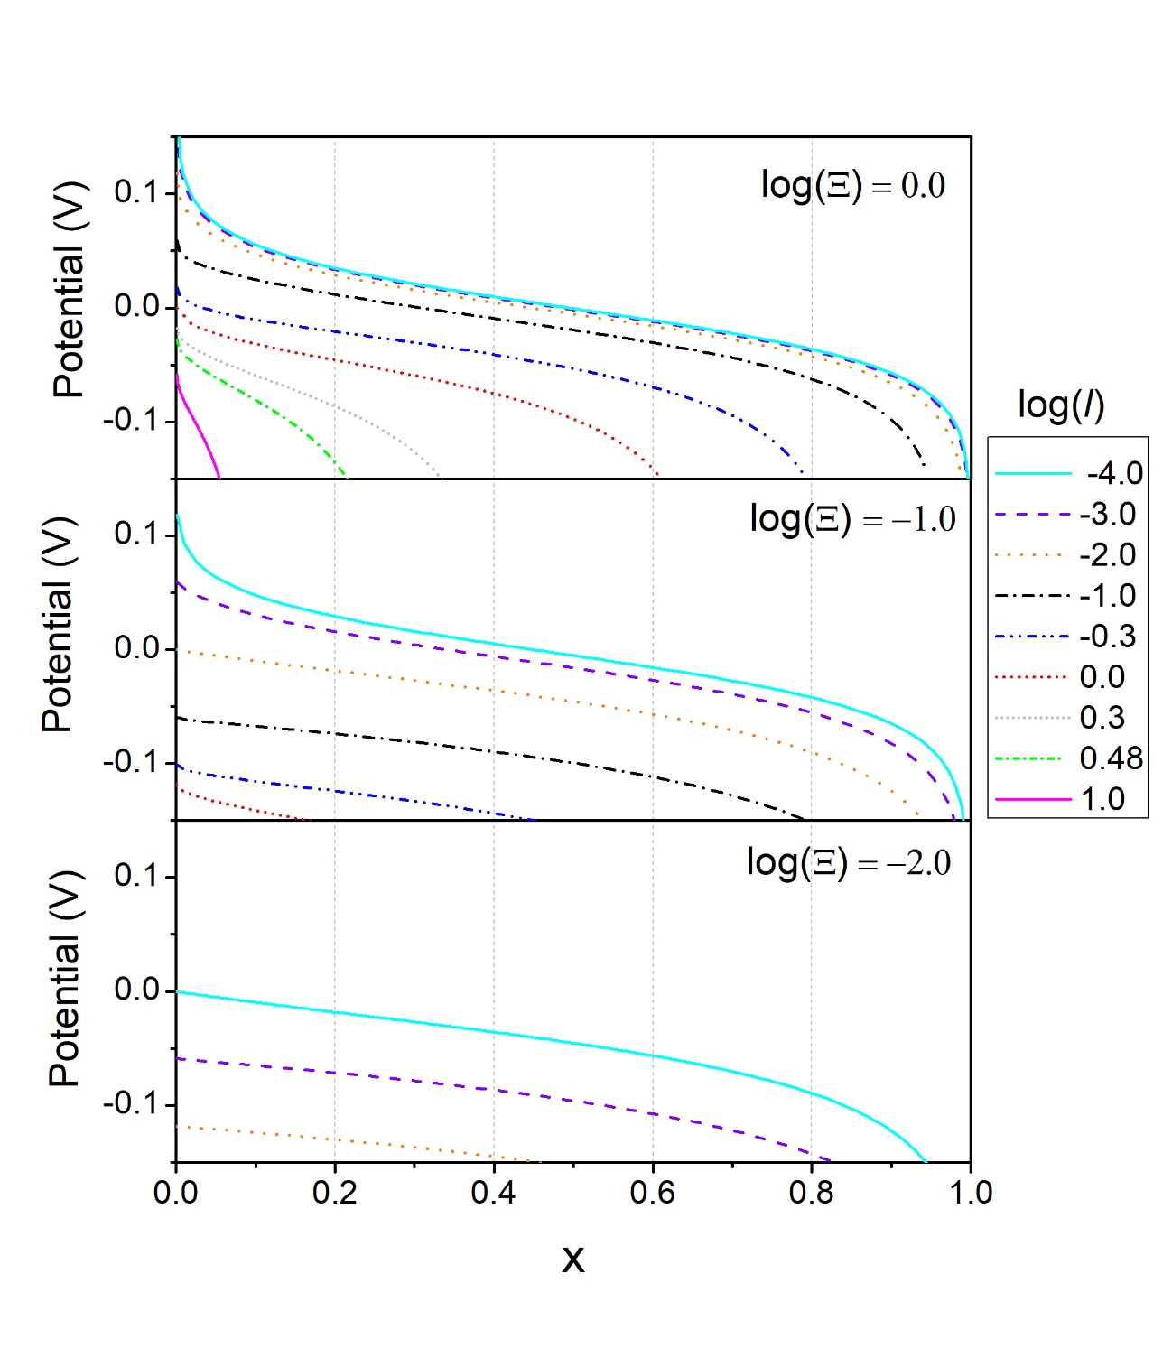
Level Diagrams
(submitted for publication)
Notes:
Switching the parameters, we can construct 3D plots or level diagramas for different geometries as observed on the right of the screen. The range of colors represents the maximum capacity reached.

